Slide 1
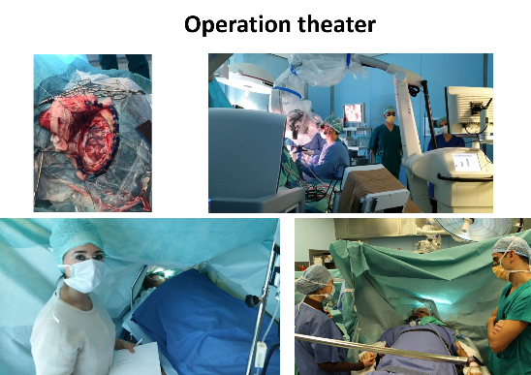
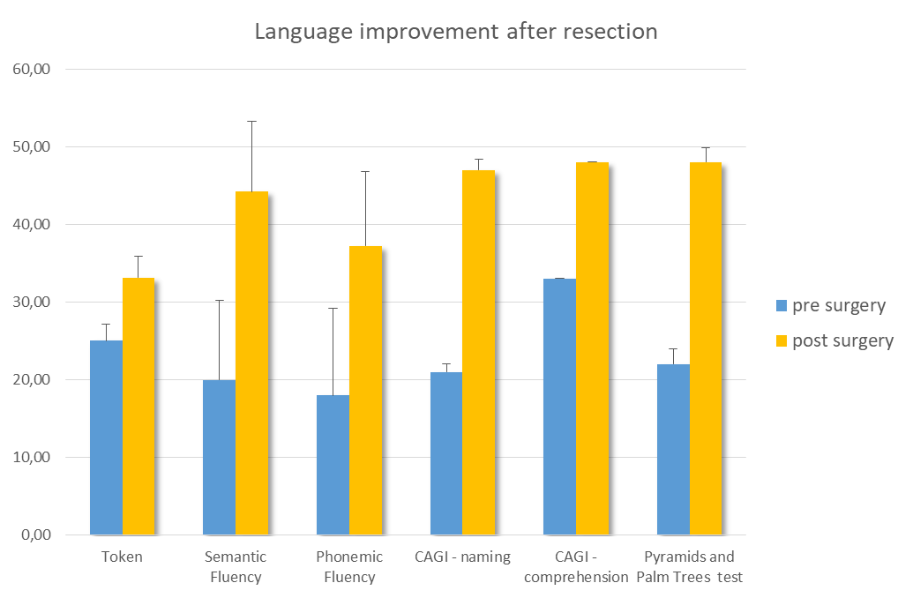
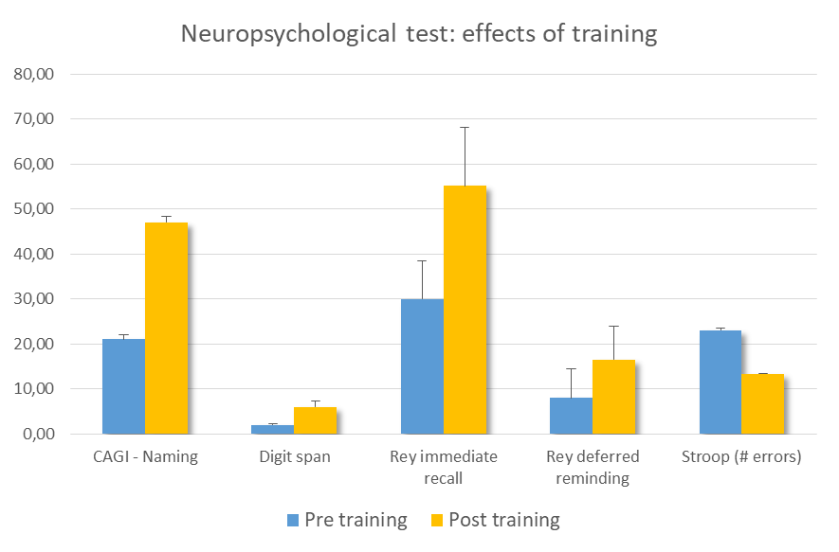
AWAKE NEUROSURGERY, EARLY REHABILITATION, REMOTE REHABILITATION: INNOVATIVE APPROACH TO CEREBRAL TUMORS
Federica Alemanno¹, Pietro Mortini², Pasquale Anthony Della Rosa¹, Elise Houdayer¹, Michele Bailo², Alfio Spina², Stefania Acerno², Carlo Mandelli², Sandro Iannaccone¹
¹ Department of Rehabilitation and Functional Recovery, IRCCS San Raffaele Hospital and Vita-Salute San Raffaele University, Milan, Italy.
² Department of Neurosurgery and Gamma Knife Radiosurgery, IRCCS San Raffaele Scientific Institute and Vita-Salute San Raffaele University, Milan, Italy.
Question
The role of the neurospychologist in awake neurosurgery for cerebral tumor resection is essential to: (1) provide the best evaluation of cognitive functions of patients, (2) help patients’ selection, (3) provide the best monitoring of cognitive functions during surgery, (4) evaluate post-surgical cognitive performances and (5) cognitive rehabilitative training.
Our objective was to design specific innovative multimodal intervention programs for patients undergoing awake neurosurgery using detailed evaluations and personalized rehabilitation trainings.
Methods
20 patients (6 Female, mean age 52.7±9 y, 16 right-handed) with gliomas in eloquent areas for cognition, language and sensorimotor functions (left fronto-temporo-parietal areas), except in 3 patients (left-handed, right-sided lesions).
Detailed neuropsychological testing before, during and after surgery (4-5 days post-surgery and at 3, 6 and 12 months FU).
Results
Patients’ clinical status ranged from asymptomatic to moderate-severe language deficits.
After surgery, no complications and no adjunctive cognitive deficits.
12 patients without cognitive deficits beforehand were still asymptomatic post-surgery. 4 patients with language deficits had slight improvements after resection followed by spontaneous remission. 4 patients underwent cognitive training after surgery followed by a period of 12 weeks of telerehabilitation. All recovered within normal values after training.
During the awake phase of surgery, the neuropsychologist constantly monitored patients’ cognitive functions and helped improving patient’s compliance.
When needed, on-site personalized cognitive training was provided. After hospital discharge, patients continued cognitive training remotely for 12 weeks, under the supervision of hospital-based trained personnel.
Conclusion
Appropriate neuropsychological assessment, monitoring and training is essential to optimize all the outcomes of awake craniotomy. Nowadays, the use of new technologies facilitates access to care and allows the transfer of personalized specific treatments directly to patients’ homes using telerehabilitation.
References
(1) Duffau H. Neurosurg Rev. 2018;41: 133–139. doi:10.1007/s10143-017-0918-9; (2) Klein M et al. J Neurooncol. 2012;108: 309–318. doi:10.1007/s11060-012-0811-x; (3) De Witt Hamer PC et al. J Clin Oncol Off J Am Soc Clin Oncol. 2012;30: 2559–2565. doi:10.1200/JCO.2011.38.4818

