Slide 1
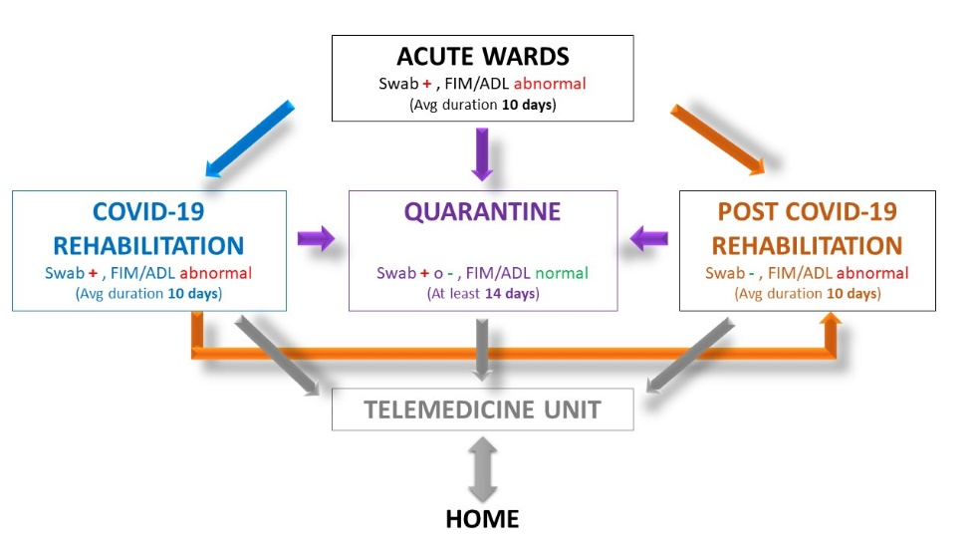
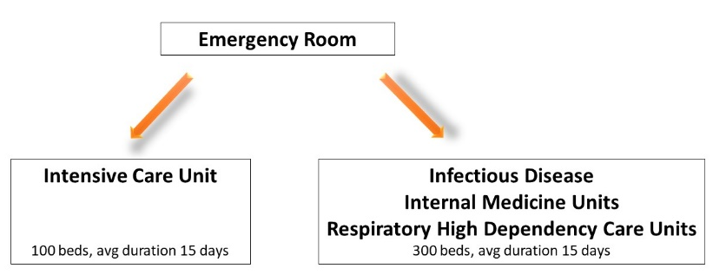
COVID-19 REHABILITATION UNIT, A NEW CLINICAL ENTITY DURING THE PANDEMIC STORM:
San Raffaele Milan Hospital experience
Elise Houdayer^{PhD}, Federica Alemanno^{PsyD, PhD}, Luigia Brugliera^{MD, PhD}, Paola Castellazzi^{MD}, Paolo Cimino^{MD}, Andrea Tettamanti^{BPT}, Sandro Iannaccone^{MD}
Department of Rehabilitation and Functional Recovery, IRCCS San Raffaele Hospital and Vita-Salute San Raffaele University, Milan, Italy.
Question
The pandemic spread of SARS-CoV-2 required specifications for the rehabilitative management of COVID-19 patients. In our experience, the pandemic evolution was characterized by 2 phases: an acute phase in which 400 intensive and sub-intensive beds were created, and a second phase in which specialized clinical pathways for complete clinical care of COVID-19 patients with focus on rehabilitation and functional recovery were implemented. Such functional rehabilitation units for COVID-19 patients were a clinical novelty. We aimed to report the experience of the San Raffaele Scientific Institute (Milan, Italy) and describe the organizational needs for such specialized COVID-19 rehabilitation Units.
Methods
Between February 1st and March 31st 2020: about 50 patients were admitted every day with COVID-19 symptoms.
In those days, about 400 acute care beds were created (Intensive Care/Infectious Diseases).
In the following 90 days: from March 2nd to May 31st, despite the presence of 60 daily arrivals to the ER, the organization of patients’ flow between wards was modified.
Several different units were created, including the COVID-19 Rehabilitation Unit, post COVID-19 Rehabilitation Unit, and Quarantine Unit.
Patients were admitted according to specific inclusion criteria. The two-month activity of the COVID-19 Rehabilitation Unit has been compared with the last year activity of the Cardiac Rehabilitation and Motor Rehabilitation Units of the Institute.
Results
More than 1000 patients have been hospitalized, with 200 patients in the COVID-19 Rehabilitation Unit (the other patients admitted to the ER were discharged home).
As many care beds as the Cardiac Rehabilitation and Motor Rehabilitation Units but required twice the amount of staff and specific instrumental equipment, use of virtual meetings to discuss patients and Telemedicine to link the different Units, improve patients’ communication with relatives and perform follow-up.
PHASE 2
PHASE 1
Conclusion
The world health systems are organizing to respond to the pandemic by implementing acute intensive care and sub-intensive care units. However, our data showed that COVID-19 Rehabilitation units must be organized, following specific clinical and organizational needs.
References
(1) Iannaccone S et al. Arch Phys Med Rehabil 2020; published online June 4; (2) Iannaccone S et al. J Rehabil Med.; (3) Brugliera L et al. (2020) Rehabilitation of COVID-19 patients. J Rehabil Med 52 (4):jrm00046.

