Slide 1
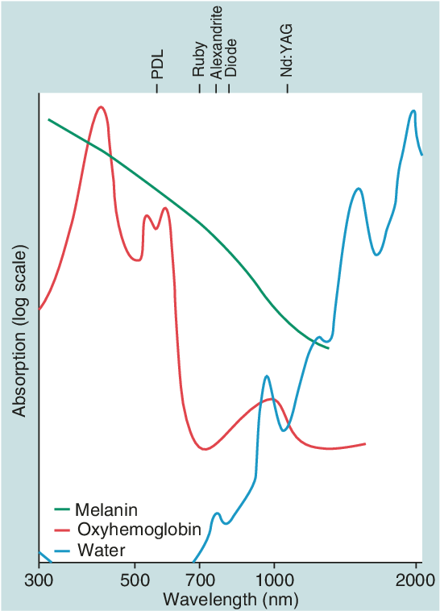
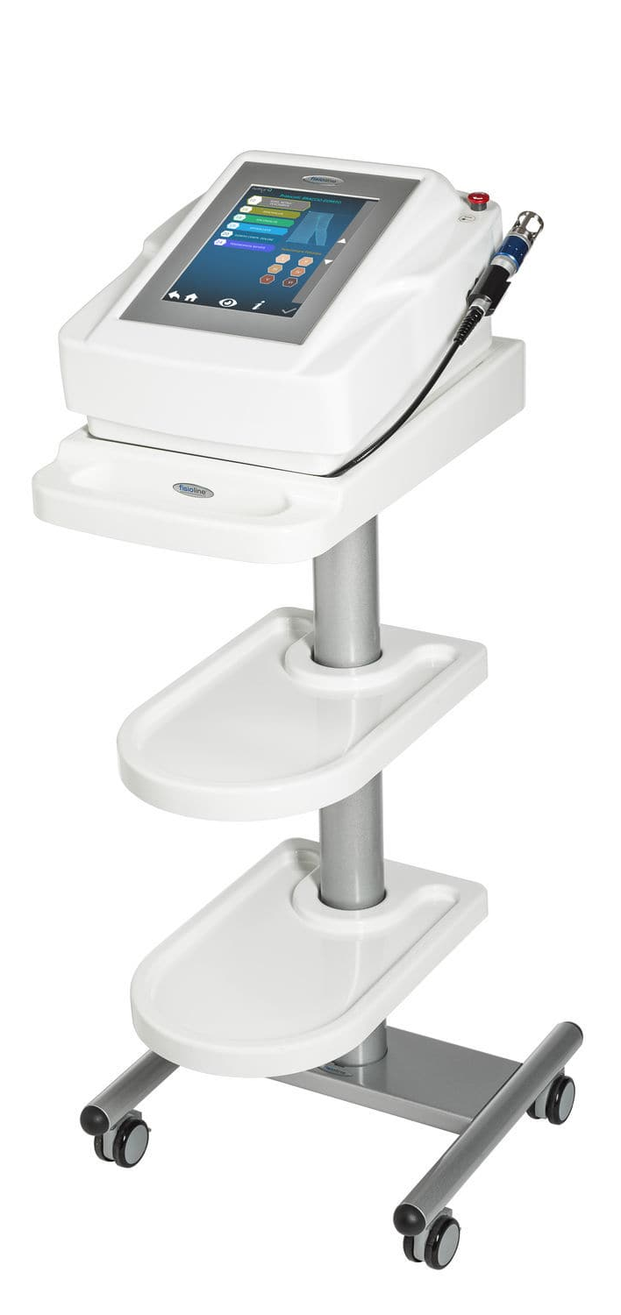
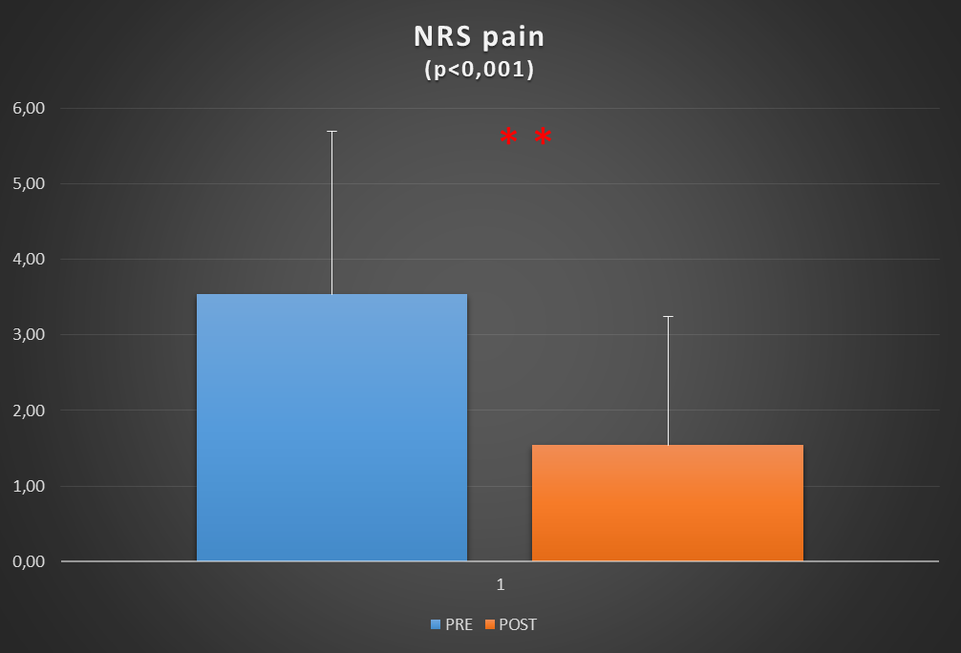
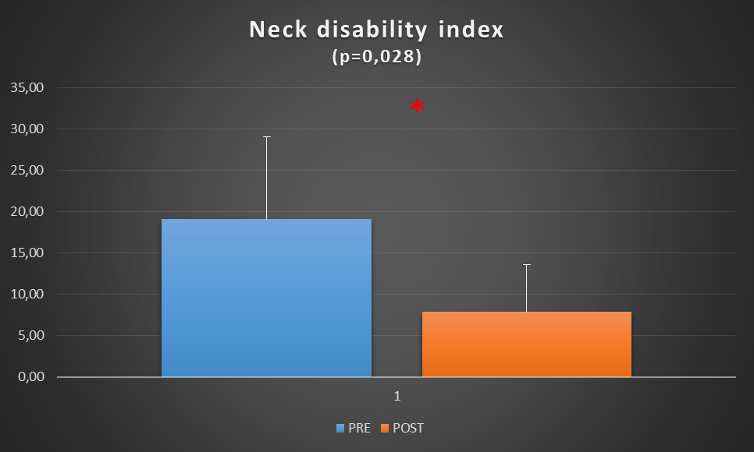
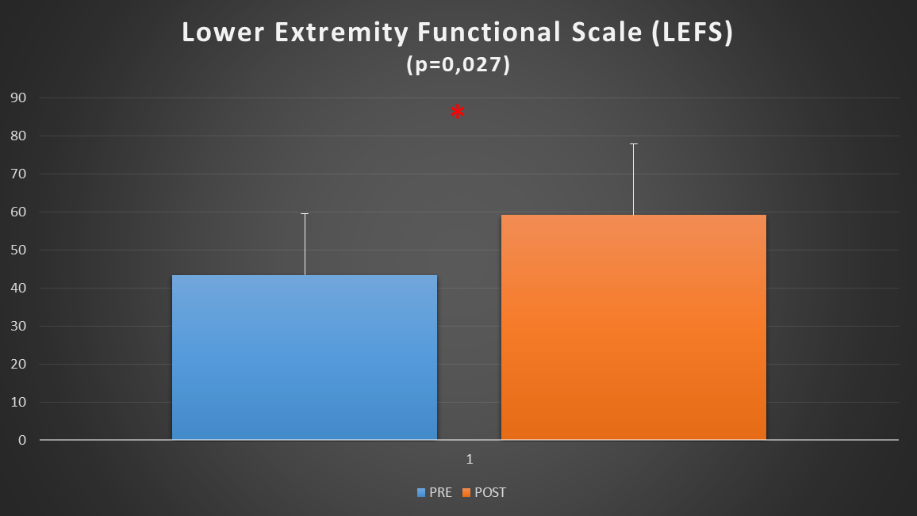
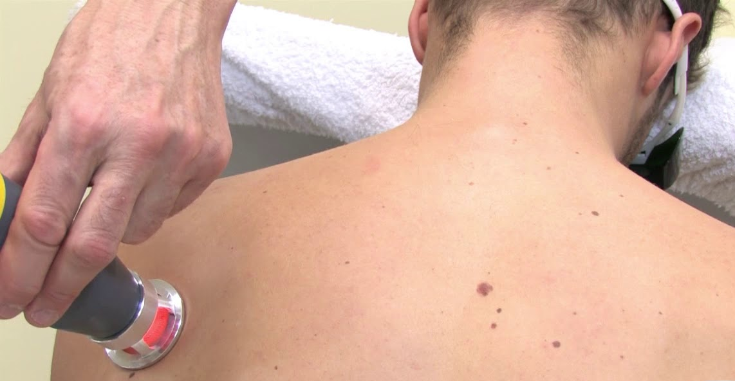
ND:YAG Q-SWITCHED HIGH-INTENSITY LASER THERAPY FOR CERVICAL AND LUMBAR CHRONIC MUSCULOSKELETAL PAIN
Elise Houdayer^{PhD}, Federica Alemanno^{PsyD, PhD}, Carlotta Bogetti^{BPT}, Luigia Brugliera^{MD, PhD}, Andrea Tettamanti^{BPT}, Sandro Iannaccone^{MD}
Department of Rehabilitation and Functional Recovery, IRCCS San Raffaele Hospital and Vita-Salute San Raffaele University, Milan, Italy.
Question
Chronic pain related to cervical or lumbar musculoskeletal disorders is a highly disabling condition severely degrading people’s quality of life. Not every patient responds to pharmacological therapies.
Laser therapy (LT) consists in the application of red and infrared light over soft tissues, injuries or lesions. LT has the ability to reduce pain and inflammation and to promote tissue repair. Nd:YAG (neodymium-doped yttrium aluminum garnet) Q-switched laser is a new generation of high intensity laser with a wavelength of 1064 nm reaching deeper layers of skin tissue. We aimed to apply such LT to reduce pain in patients presenting with chronic musculoskeletal disorders.
Methods
28 patients (9 Female, mean age 65±16.3 y).
Chronic lumbar or cervical musculoskeletal pain (no surgical indications, resistant to pharmacological treatments).
5 sessions of Nd:YAG Q-switched laser, 2 or 3 times a week.
Laser treatment: 6 min, mean power=7.4 W, impulse energy=922 µj, impulse duration=7ns and peak power=132 kW.
Evalutations: PRE, POSTtreatment, and at 2 months follow-up (FU): NRS pain scale and Lower Extremity Functional Scale (LEFS) or Neck Disability Index functional scale.
Patients’ pharmacological therapy: unchanged during the whole time of treatment.
Results
After treatment: 25 patients reported reduction in pain sensation and 3 patients reported no change.
NRS pain score PRE: 3.54±2.2 vs. NRS pain POST: 1.54±1.89; p<0.001.
Significant improvements at the functional scales: lumbar (LEFS pre treatment: 43.5±16.13 vs LEFS post treatment: 59.17±18.63; p=0.027) and cervical disorders (Neck Disability Index pre treatment: 19.11±10.02 vs post treatment: 7.86±5.73; p=0.028).
At 2 months FU: NRS pain remained unchanged compared to post treatment (p>0.05).
NSR Pain
Neck Disability Index
Lower Extremity Functional Scale
Conclusion
This study shows efficacy of high-intensity Nd:YAG Q-switched laser therapy to reduce chronic pain in cervical and lumbar musculoskeletal disorders. The effects were still present 2 months after the end of treatment.
References
(1) Abdelbasset, Walid Kamal et al. Medicine: September 04, 2020 - Volume 99 - Issue 36 - p e22098 doi: 10.1097/MD.0000000000022098; (2) Angelova and Ilieva. Pain Res Manag. 2016;2016:9163618. doi: 10.1155/2016/9163618; (3) Basford et al. Arch Phys Med Rehabil. 1999 Jun;80(6):647-52. doi: 10.1016/s0003-9993(99)90167-3.

