Slide 1

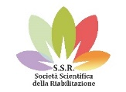

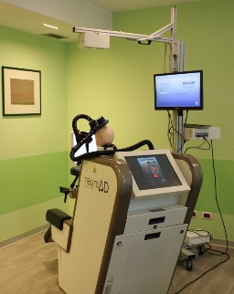
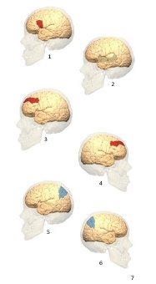
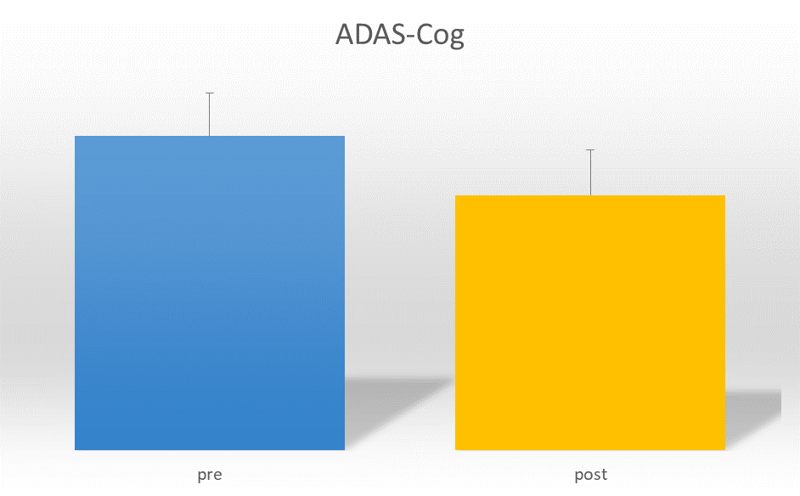
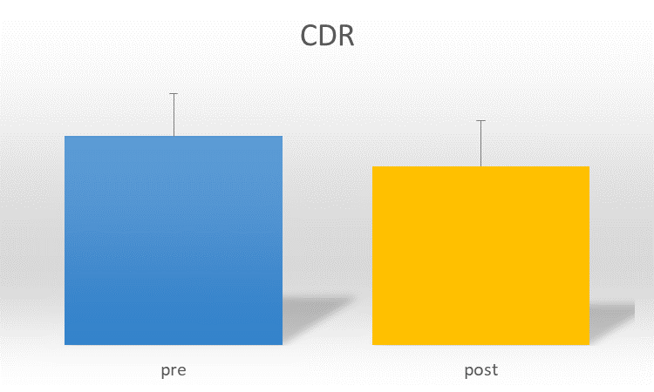
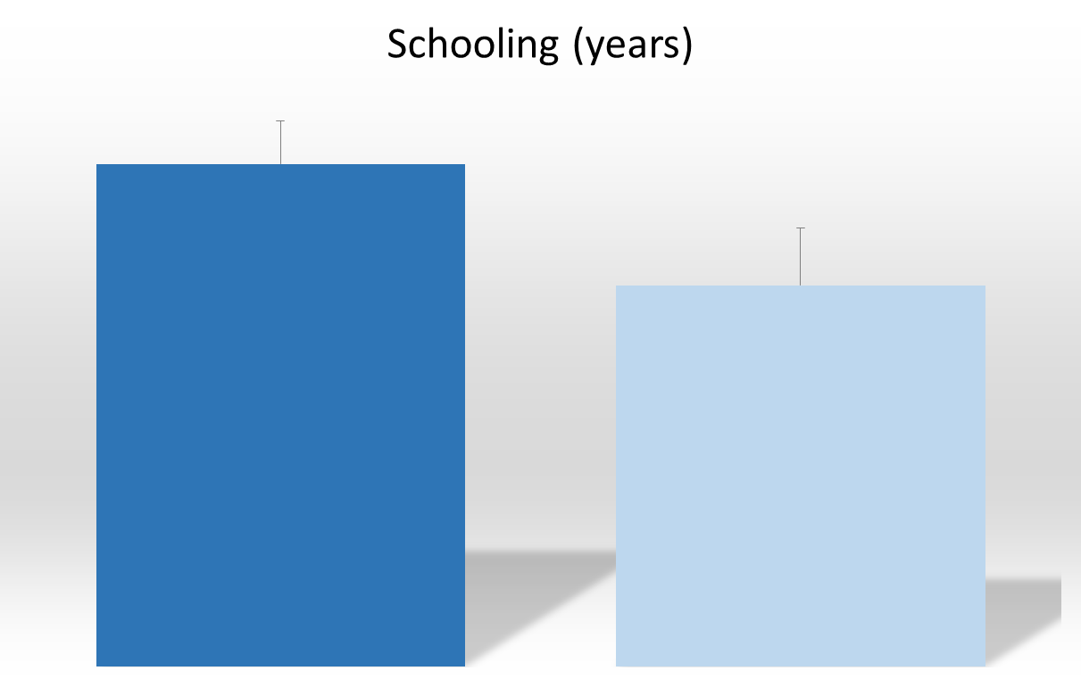
COGNITIVE IMPROVEMENTS IN MILD TO MODERATE ALZHEIMER’S DISEASE AFTER HIGH-FREQUENCY rTMS COMBINED WITH COGNITIVE TRAINING
Federica Alemanno^{Psy.D., Ph.D.}, Elise Houdayer^{Ph.D.}, Anna Parma^{Psy.D.}, Arianna Puggioni^{M.D.}, Valeria Golzi^{M.D.}, Alessandra Marcone^{M.D.}, Sandro Iannaccone^{M.D.}
Department of Specialistic Rehabilitation of Neurological, Cognitive and Motor Disorders, IRCCS San Raffaele Hospital and Vita-Salute San Raffaele University, Milan, Italy.
Question
Alzheimer’s Disease (AD) is the prevalent cause of dementia in the elderly. Treatments should include pharmacological and neuropsychological treatments as well as non-invasive brain stimulation (NIBS) to best stimulate patients’ cognitive reserve (CR). Repetitive transcranial magnetic stimulation (rTMS) is a non-invasive tool to modulate cortical excitability. When combined with simultaneous cognitive training, rTMS can significantly improve cognitive functions over time. We aimed to investigate the effects of such treatment on cognitive functions of patients presenting with mild to moderate AD.
Methods
45 mild-to-moderate AD patients: 21 F; mean age 70.6±8.6y; mean Mini Mental Scale Examination score before treatment: 21.3±6.8.
30 sessions of rTMS (10Hz) combined with cognitive training (duration: 6 weeks) (Figure 1).
6 cortical areas: bilateral dorsolateral prefrontal cortex, Broca, Wernicke, and bilateral parietal somatosensory association cortices (Figure 2).
Pre, post treatment and at 6 months follow-up (FU): neuropsychological evaluation (language, memory, attention, executive functions) + ADAS-Cog (Alzheimer's Disease Assessment Scale-Cognitive Subscale) + Clinical Dementia Rating scale (CDR).
Figure 1
Figure 2
Neuronavigator
Focal rTMS
Operator screen
Touch screen for cognitive training
Results
Significant improvements at the ADAS-Cog (PRE: 26.6±13.8 vs. POST: 21.3±13.7, p=0.001)
Significant improvement at the CDR (PRE: 0.8±0.4 vs. POST: 0.6±0.4, p=0.048).
Responders to treatment had a significantly higher education (14.5 vs 12y, p=0.043).
At FU (6 months), responders’ CDR scores were still maintained.
*
p=0,001)
*
p=0,048)
*
p=0,043)
Conclusion
10Hz rTMS combined with cognitive training could induce functional and symptomatic improvements in AD, especially in patients with higher education. Besides, cognitive improvements in AD have been shown to be greatly correlated with residual cognitive functions. The benefits evidenced in our study could be directly dependent on the engagement of cognitive reserve in these patients, suggesting that this treatment might be particularly suited for patients with higher cognitive reserve.
References
(1) Bentwich et al, J Neural Transm (Vienna). 2011 Mar;118(3):463-71. doi: 10.1007/s00702-010-0578-1. Epub 2011 Jan 19; (2) Rabey et al, J Neural Transm (Vienna). 2013 May;120(5):813-9. doi: 10.1007/s00702-012-0902-z. Epub 2012 Oct 18; (3) Lee et al, J Clin Neurol. 2016 Jan;12(1):57-64. doi: 10.3988/jcn.2016.12.1.57. Epub 2015 Sep 11; (4) Nguyen et al, Neurophysiol Clin. 2017 Feb;47(1):47-53. doi: 10.1016/j.neucli.2017.01.001. Epub 2017 Feb 1.

